Slide 1
Lab 4B Solution

Slide 2
What are Collectors? (not covered this sem)
Reduce a Stream to something else
Interface Collector<T,A,R>
T – Type of input (Beginning)
A – Type of the accumulator (Middle)
R – Type of Result (End)

Slide 3
Anatomy of Collectors
Specify: <T,A,R>
-Supplier<A> supplier() – Specify a starting point for A
-BiConsumer<A,T> accumulator() – Combine T into A
-BinaryOperator<A> combiner() – Combine multiple A (when concurrent)
-Function<A,R> finisher() – Convert final A into end result R
-Set<Collector.Characteristics> characteristics() – Tell Java if the collector is concurrent, if finisher() is the identity (x -> x) and if the order of the input and output can be different

Slide 4
How to convert Events to Lambdas?
Change Event to take in a Function
Find places that use new ArrivalEvent or new DoneEvent
Change them to create a new Event, but pass in the logic as a Function

Slide 5


Event
Store the function
Simulate applies the function()
Remove DoneEvent and ArrivalEvent

Slide 6

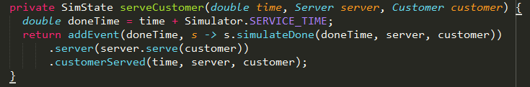
DoneEvent

Slide 7

ArrivalEvent

Slide 8
How to convert loops and ifs to streams?
Treat it like you have all the data at once
Apply transformations to them

Slide 9
Main
Input: Customer arrival timings
Output: Single SimState holding all the statistics
Intuitively, reduction from arrival timings to SimState

Slide 10
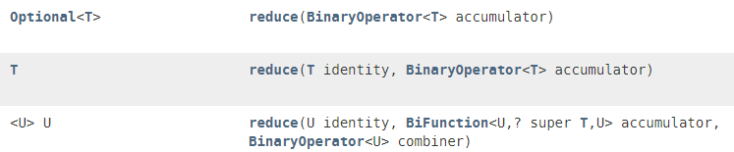
Which reduce to use?
Start with a “blank” Simulator
Add ArrivalEvents into it one by one
Sim.run() to get final one

Slide 11
Which reduce to use?
Start with a “blank” Simulator
Add ArrivalEvents into it one by one
Sim.run() to get final one

Slide 12
“Blank” simulator is an identity
Accumulate each ArrivalEvent into the Simulator
No need combiner
Cannot use this one as it combines 2 vars of same type

Slide 13

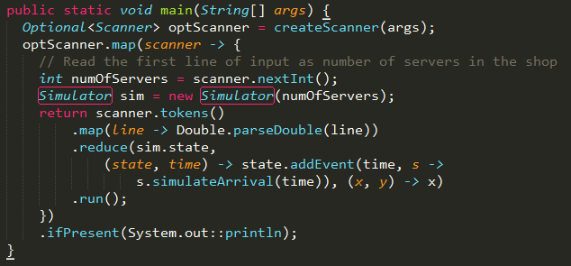
Main
Read many strings as a Stream
Convert to Double
“For each arrival time”
Convert to an Event
Don’t need a combiner
This is sim.state.run() – run() is moved to SimState

Slide 14
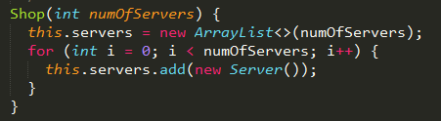
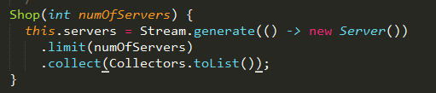
Shop

Slide 15
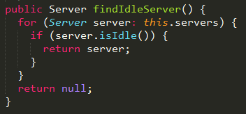
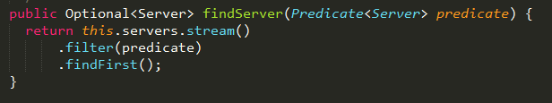
Shop
(Example shown in last lab)

Slide 16
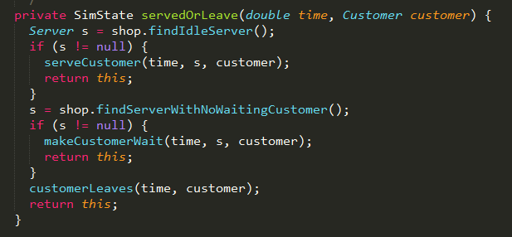
SimState

Slide 17
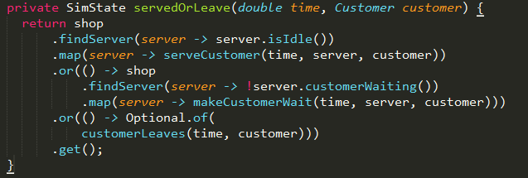
SimState
Only if not empty

Slide 18
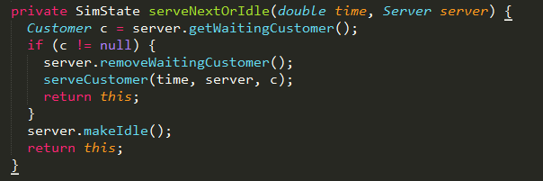
SimState

Slide 19
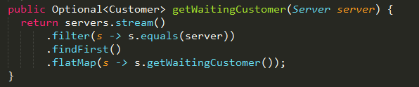
Shop (getWaitingCustomer)
Optional<Server>
Why flatMap? .map returns Optional<Optional<Customer>>

Slide 20
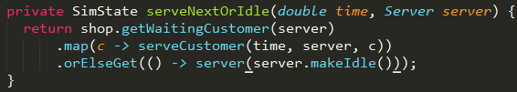
SimState

